Slide 1
Speech production
COMP.SGN.120 Introduction to Audio and Speech Processing
Okko Räsänen
23.11.2023

Slide 2
Today’s learning goals
Basic physiological components of speech production
Acoustic ingredients of speech signals
Source-filter model of speech production
Fundamental frequency (F0)
Phone and phoneme
Excitation generation
Articulation
Coarticulation

Slide 3
The speech chain

Slide 4
The speech chain

Slide 5
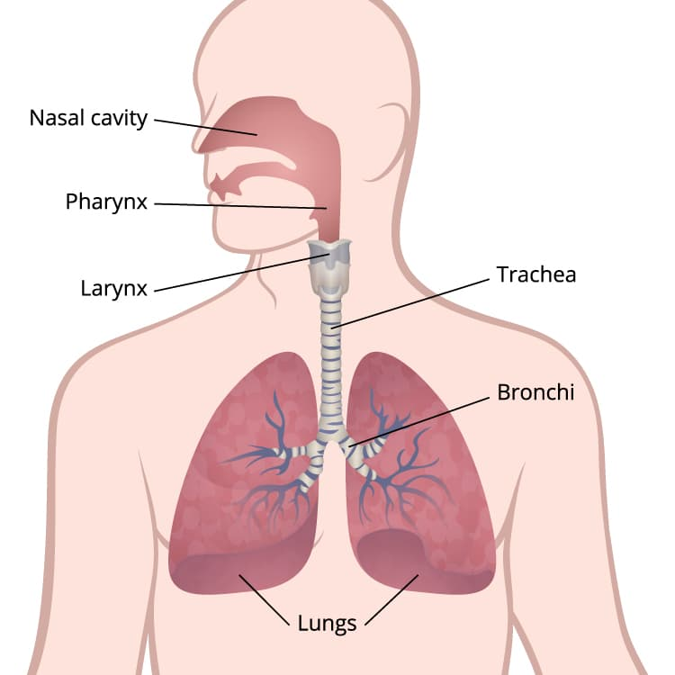
What is needed for human sound generation? Basic sounds? Time-varying speech-like sounds?
Image from cdc.gov

Slide 6
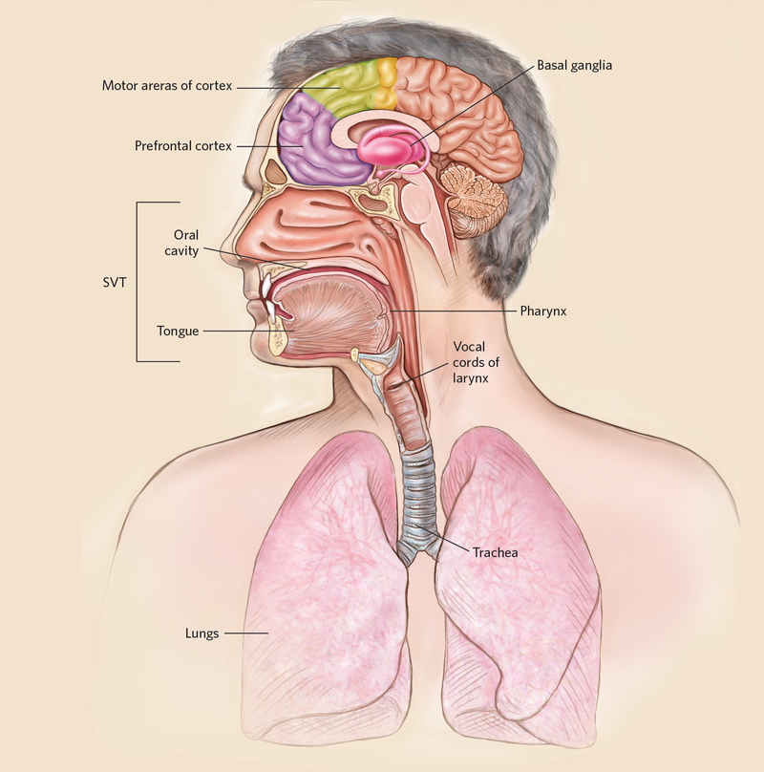
An overview of speech production
Brain: conversion of an “idea-to-be-communicated” into a sequence of motor commands.
Lungs: provides air-pressure through contraction.
Vocal folds: periodic vibration due to lung-pressure + motor control
Vocal tract: articulators (tongue, lips, jaw etc.) filter the signal in time according to neural control
Lips + nose: sound radiation to external environment.
Source: The Scientist Magazine

Slide 7
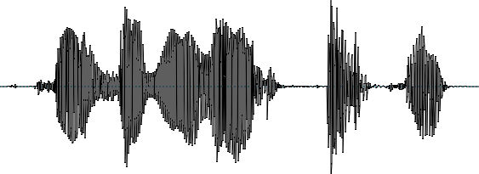
Acoustic theory of speech production
The source-filter model of speech production (Fant, 1960): the speech production mechanism can be separated into three independent stages:
1) excitation from the glottis (voiced sounds) or as turbulent noise (unvoiced sounds)
2) filtering in the vocal tract (shaping of the spectrum)
3) lip radiation from the tract to the environment
air flow
from
lungs
voiced sounds
Glottal excitation
An idealization, but a very effective one!
Vocal tract filter
Lip radiation
+
Turbulent noise
speech air pressure wave
Articulation
unvoiced sounds
Phonation

Slide 8
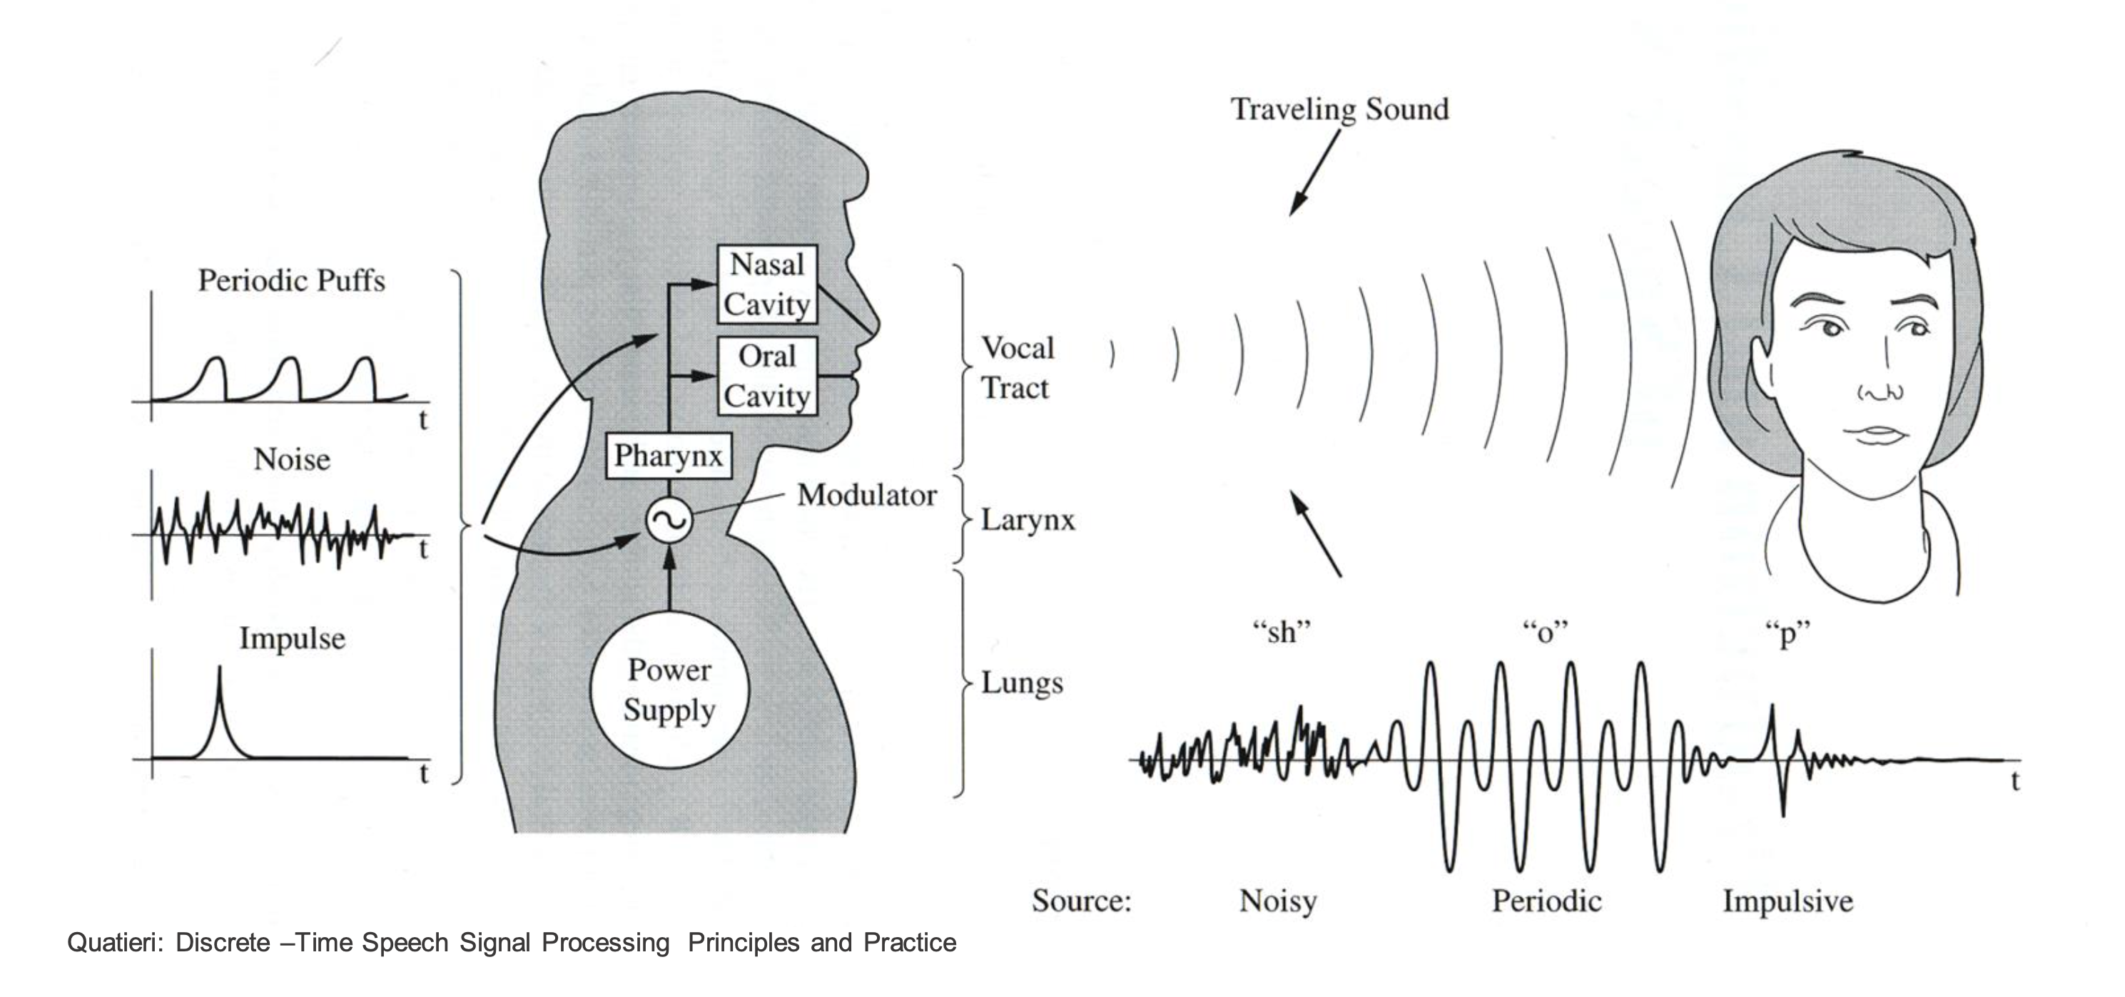
Acoustic ingredients of a speech signal
Three basic ingredients:
1) Different types of quasi-stationary noises (“unvoiced” speech)
2) Different types of impulsive bursts (sudden releases of air)
3) Periodic vibrations (“voicing”)
+ Interleaved periods of silence

Slide 9

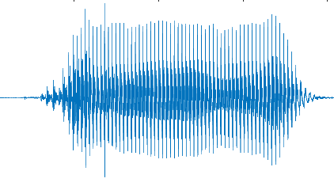
The full chain (source-filter model)
Glottal excitation
×
×
Vocal tract filter [a]
Lip radiation

Slide 10
The full chain (source-filter model)
Glottal excitation
×
×
Vocal tract filter [i]
Lip radiation

Slide 11
Periodicity and F0
resonant peaks
one F0 period
An example waveform of a voiced speech sound [o]
Periodic speech waveforms consist of two components:
1) Periodic excitation at a fundamental frequency (F0) ← source
2) Acoustic resonances driven by the excitation (at multiples of F0) ← filter

Slide 12
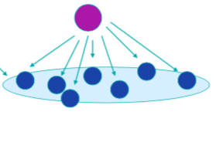
Basic speech sounds: phones
Speech as sequential production of elementary speech sounds: phones.
Identity determined by excitation style and concurrent articulatory gestures.
Denoted with square brackets, e.g. [p] or [i]. “Cat” = [k ae t]
Phones are physical realizations of abstract phonemes.
Phoneme = a theoretical concept
Phonemic contrast: an acoustic change that changes the meaning of a word.
Denoted with slashes. “pat” vs. “bat” = /p ae t/ vs. /b ae t/
Allophones = same phoneme, different phone (depends on language)
E.g., [r] and [l] are allophones in Japanese, but different phonemes in English.
Phones are universal, phonemes are language-dependent.
English has approx. 41 phonemes, Pirahã has 11.
There are NO letters in speech, only in writing.
phoneme
acoustic variations
(c) UKL99

Slide 13
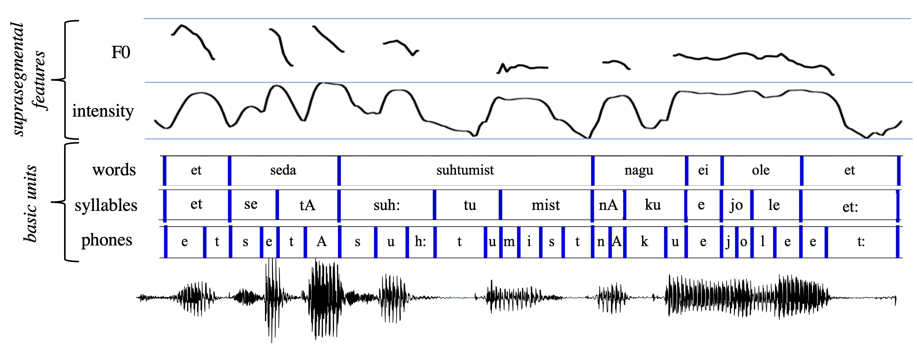
Larger units of speech
Phones make up syllables (rhytmic units) and words (meaning-bearing units).
Basic longer unit of speech is an utterance: a continuous speaking act separated by pauses.

Slide 14
Excitation generation in speech production

Slide 15
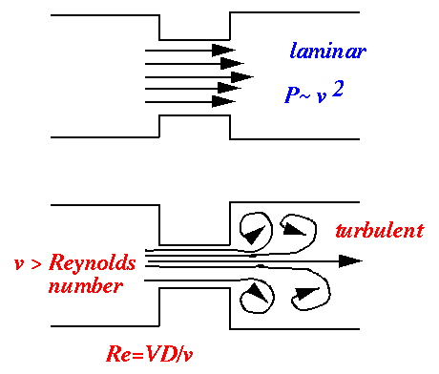
Phones and excitation
Excitation: generation of acoustic energy (at f > 0 Hz).
Phones can have two types of excitation:
Voiced excitation: vibration of the vocal folds (glottis).
Unvoiced excitation: airflow turbulence due to a constriction somewhere in the vocal tract.
Basic division into vowels and consonants.
All vowels are voiced (=glottal excitation) (e.g., [a, i, u]).
Consonants can be voiced (e.g., [v, m, n, l]) or unvoiced (e.g., [f, k, p, t]).
Laminar vs. turbulent flow in a tube.
From https://www.ims.uni-stuttgart.de/institut/arbeitsgruppen/ ...ehemalig/ep-dogil/EGG/page6.htm

Slide 16
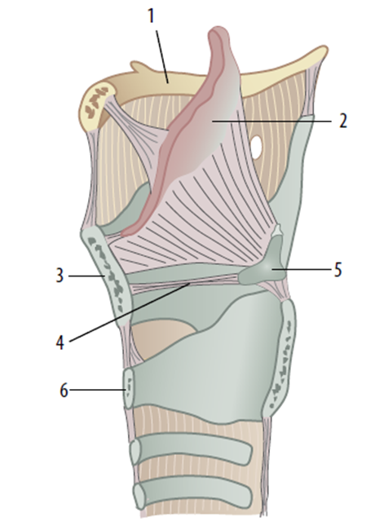
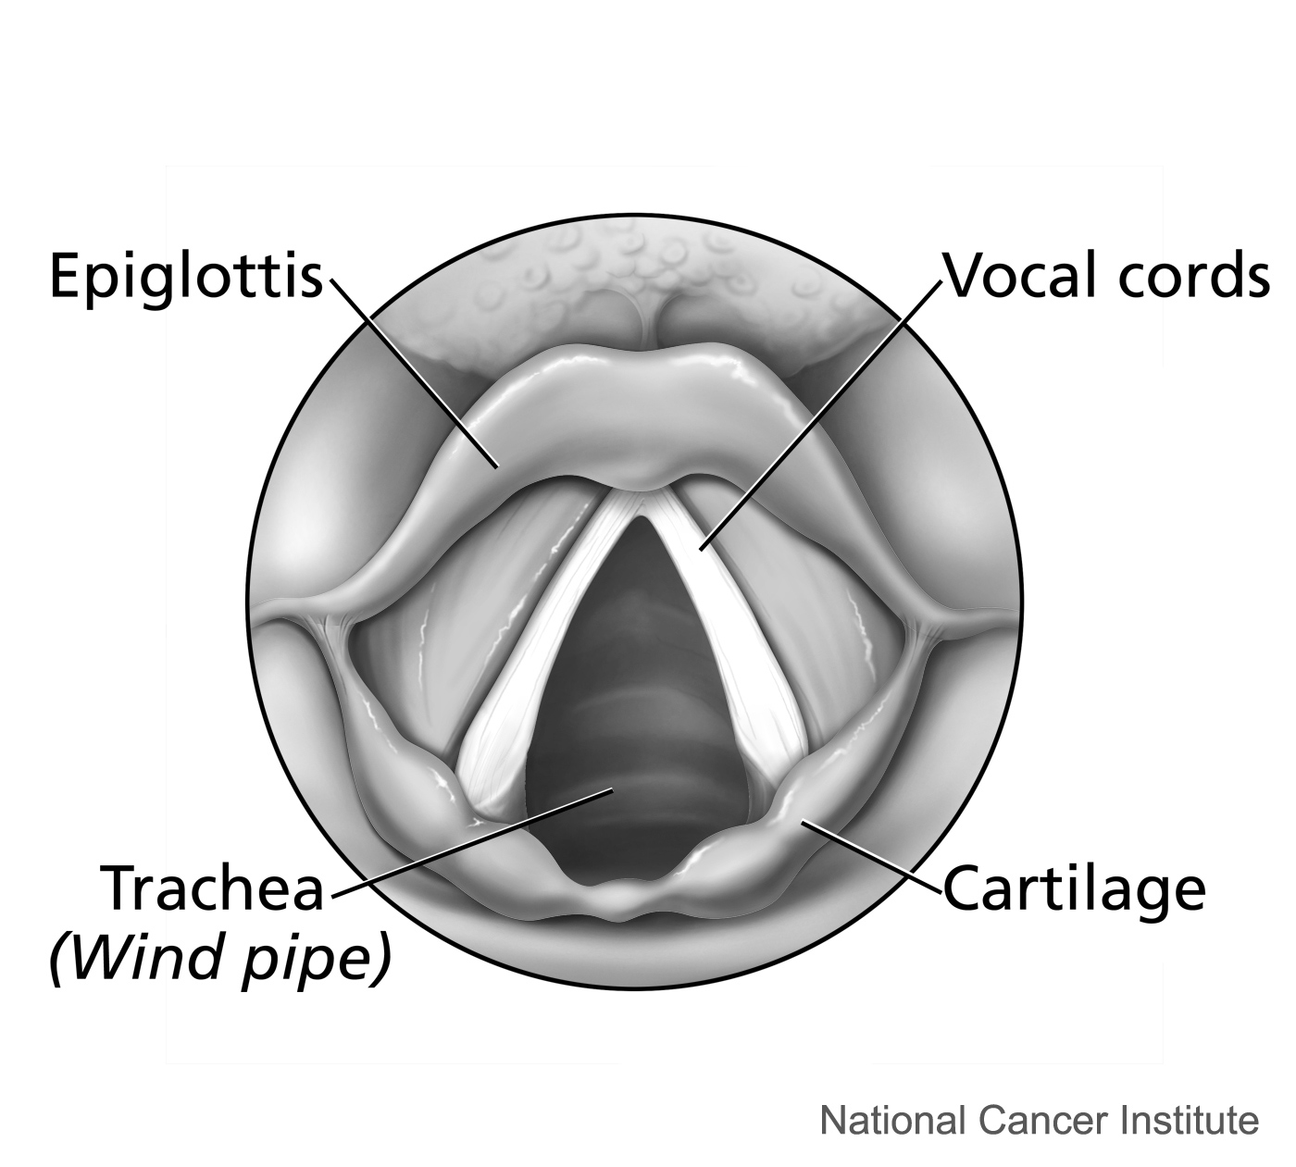
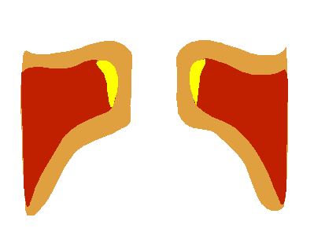
Voicing, vocal folds, and F0
Vocal folds (aka. vocal cords): two pieces of mucous membrane in the larynx.
Attached to the thyroid and arytenoid cartilages at front and back.
The gap between the folds is called “glottis”.
The degree of glottis closure is controlled by muscles.
When open, air can pass from lungs to the vocal tract. Closure blocks the air flow.
Air-pressure from the lungs + tension in the cords → oscillation due to Bernoulli effect → periodic air flow pulsation to the upper tract
Source: Mäkitie & Juutilainen / Duodecim
Source: Wikipedia

Slide 17

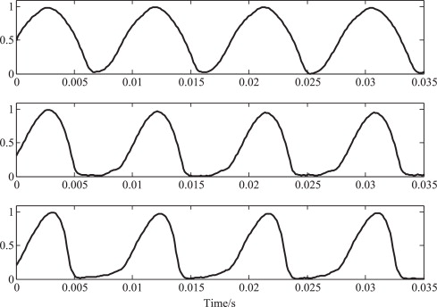
Voicing, vocal folds, and F0
Air pulsation through the vocal folds forms an glottal air volume velocity waveform v(t).
Can be treated as a planar wave through the vocal tract.
The frequency of vocal fold oscillation is called the fundamental frequency (F0) of speech.
Shape of glottal volume velocity waveform is affected by phonation style: e.g., modal, creaky, breathy, whisper.
F0 and phonation style can be controlled by muscle tension in the larynx.
Each speaker has “baseline” F0.
Male F0 lower (≈ 70–200 Hz) than female (≈ 150–450 Hz).
v(t)
time (s)
Source: Wikipedia

Slide 18
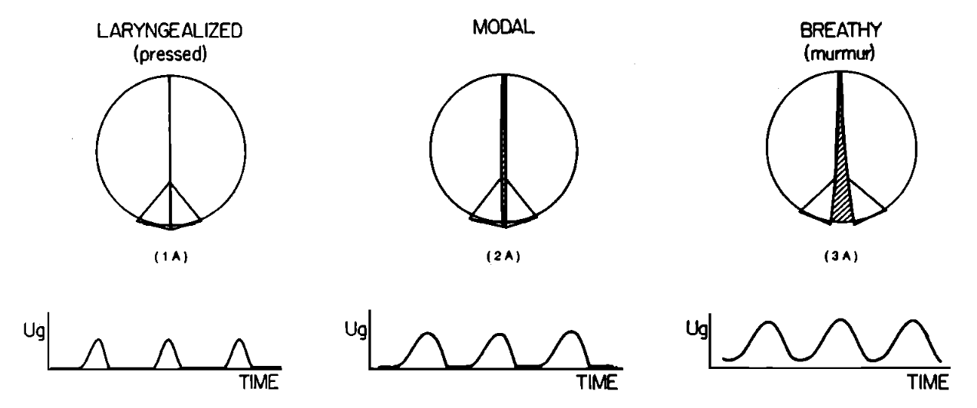
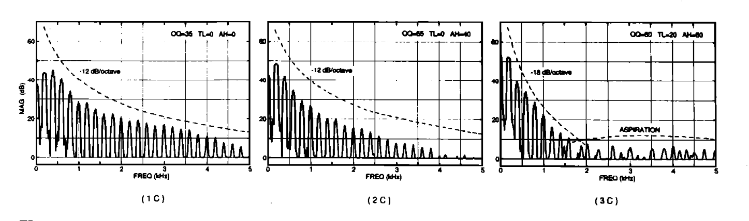
Phonation styles
From Klatt & Klatt (1990)

Slide 19

Vocal folds (viewer discretion warning!)
https://www.youtube.com/watch?v=-NmYtzaamN0

Slide 20
Do-it-yourself:
Choose a vowel sound (e.g., [a] or [i]) and produce it with different F0 frequencies.
Try not to move your articulators.
You can also try humming with your mouth closed, exhaling through nose.
Observations?
Next, try to produce a vowel (e.g., [a] or [i]) with different phonation styles while keeping F0 the same.
Observations?
Turbulence: try producing a fricative (e.g., [s] or [f]) by gradually increasing the airflow.
Does turbulence always occur?
Can you make fricatives while inhaling?

Slide 21
Articulation

Slide 22
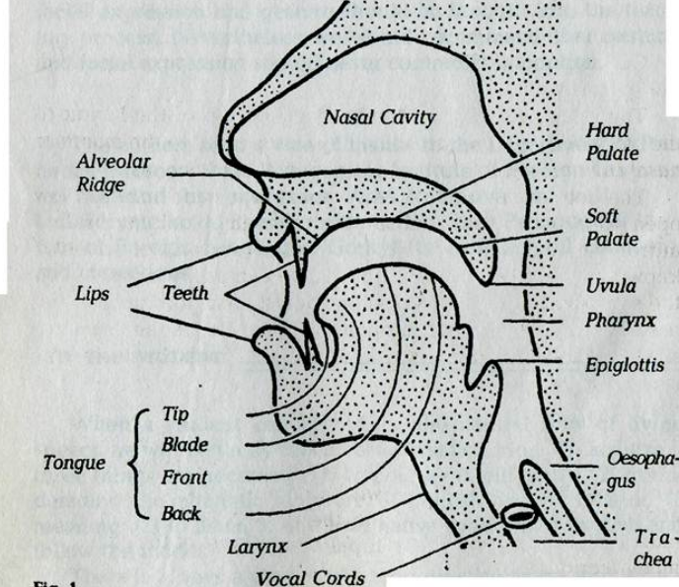
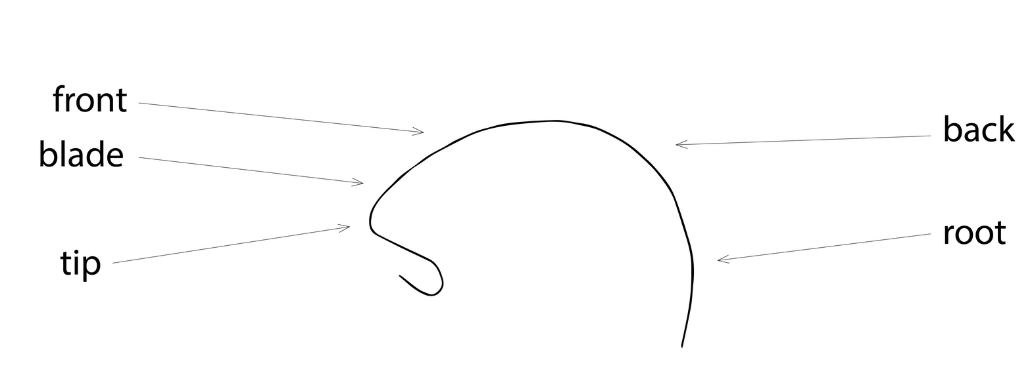
Articulation
Articulation = active movement of articulators to filter the excitation in a desired manner.
Primary active articulators: tongue, jaw, lips, velum
(Typical) passive articulators: teeth, alveolar ridge, hard & soft palate, uvula
Changes acoustic resonance characteristics of the vocal tract
Tongue can be further divided into different parts.
E.g., tip, blade, body, and base,
Or: tip, blade, front, back, root.
https://englishpronunciationroadmap.com

Slide 23
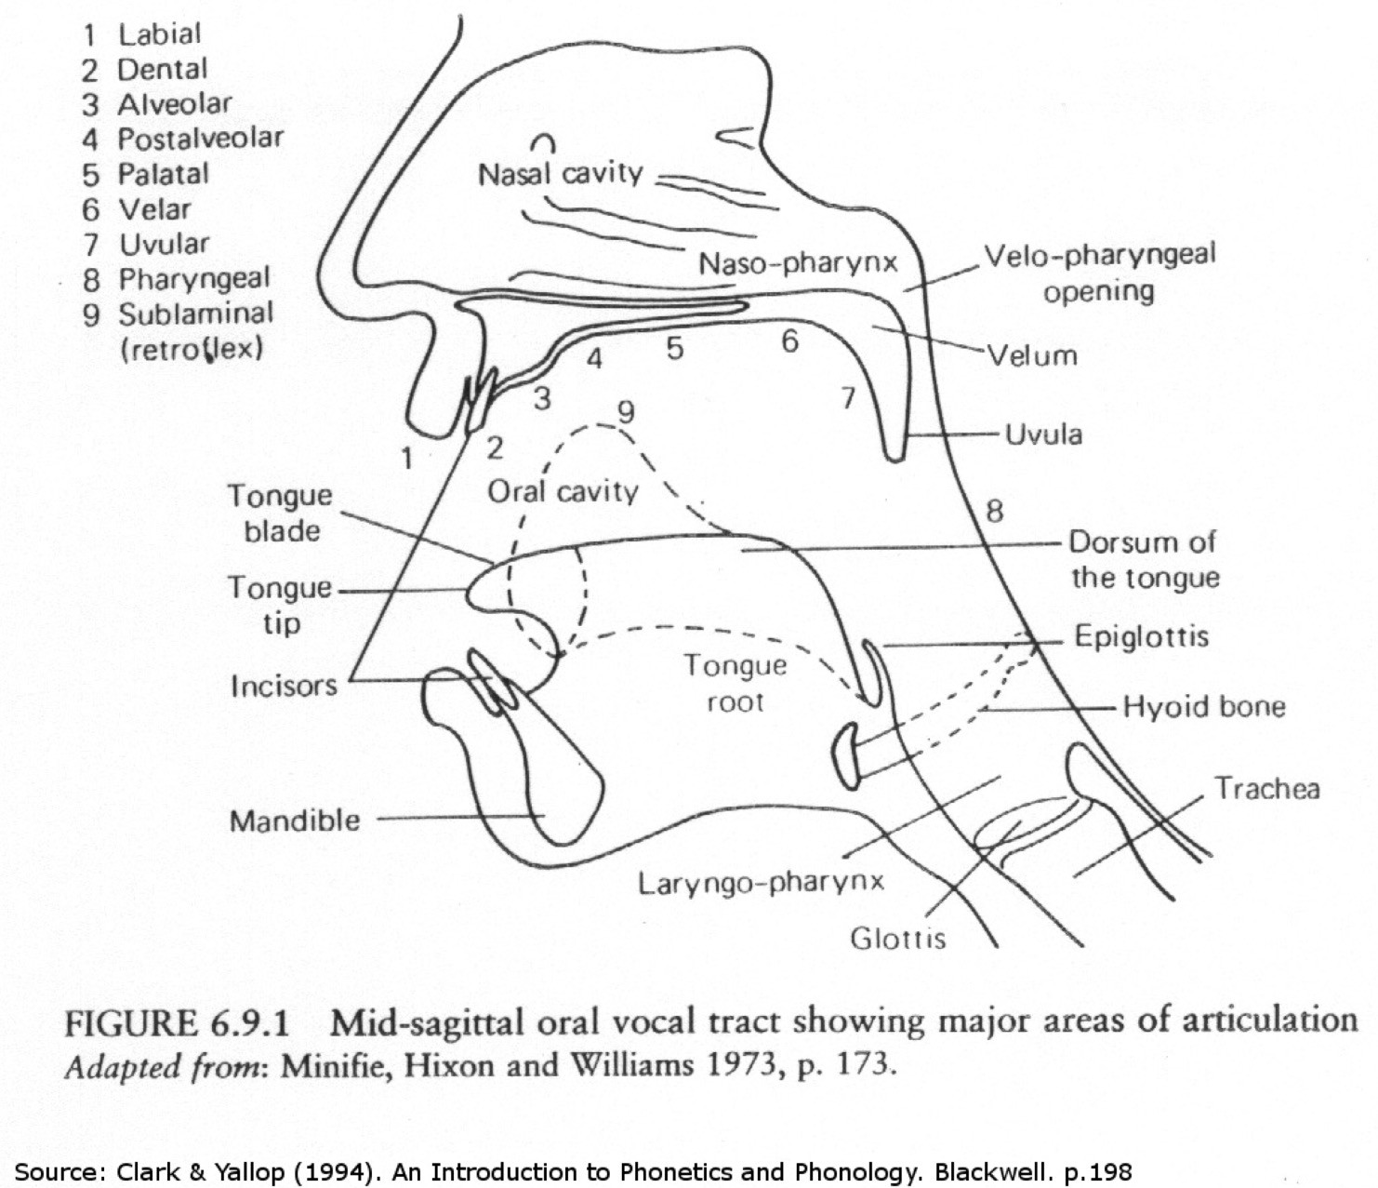

Slide 24
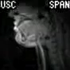
Articulation (normal speed)
https://www.youtube.com/watch?v=Nvvn-ZVdeqQ

Slide 25
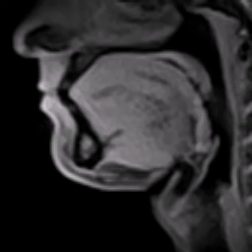
Articulation (slowed down)
https://www.youtube.com/watch?v=uTOhDqhCKQs

Slide 26
Activation: let’s vowelize
Try alternating between [i], [u] and [a] sounds.
Focus on moving only what is necessary to produce them.
Try to keep F0 fixed.
Observations?
Try to alternate between [i] and [y] sounds.
What changes now?

Slide 27
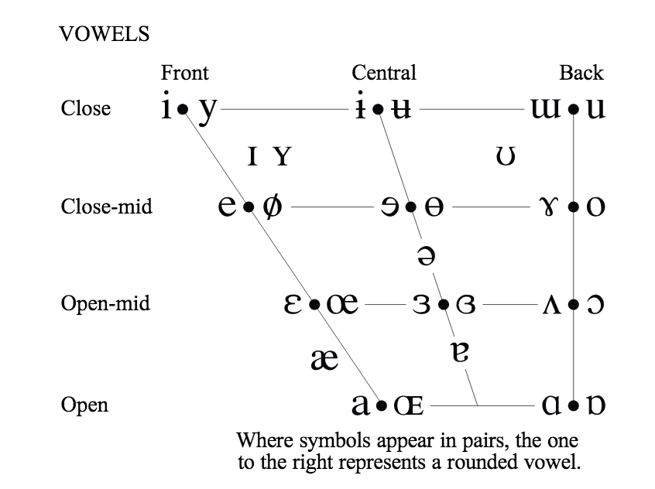
Articulation of vowels
Vowel frontness/backness (tongue position on back/front axis)
Vowel openess/closeness (tongue position on up/down axis; sometimes “low” vs. “high”)
Lip roundedness (effective lengthening of the vocal tract)
IPA vowel chart

Slide 28
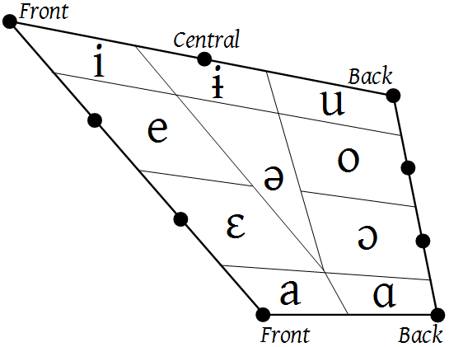
Tongue position and vowel resonances
F1
F2
[i] = close front vowel → low F1, high F2
[a] = open back vowel → high F1, low F2
[u] = close back vowel → low F1, low F2
F1
F2
F2
close
F1
F1
F2
open
Adapted from Daniel Jones & Wikipedia
Reproduced with permission from Airaksinen (2018).
Resonances of the tract = formants, denoted as F1, F2, F3 …

Slide 29
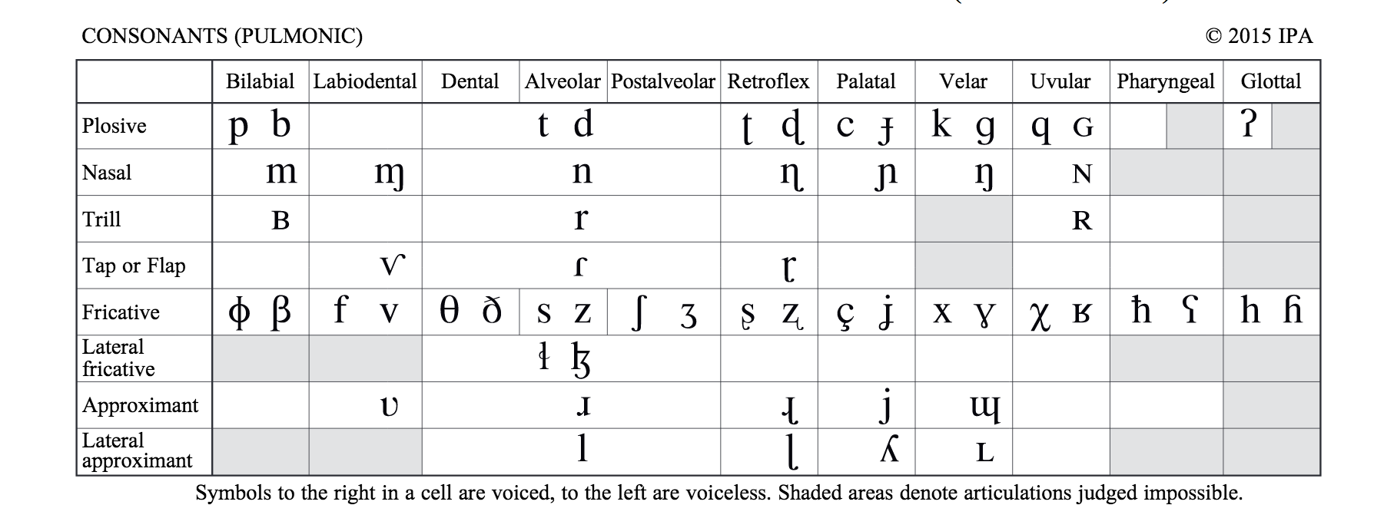
Articulation of consonants
Consonants can be determined according to three features:
Place of articulation: where is the constriction?
Manner of articulation: what type of constriction?
Phonation style: voiced, unvoiced?
unvoiced voiced
(<-- front) Place (back -->)
Manner

Slide 30
Activation: let’s make some consonants
Plosives: Try producing [p] and [b].
What is different?
Alternate between [p] and [k] and [t] (e.g., [pa], [ka], [ta])
What changes now?
Labiodentals: try [f] and [v]
What happens in [l] (such as in ”like”)?
Where’s the airflow?

Slide 31
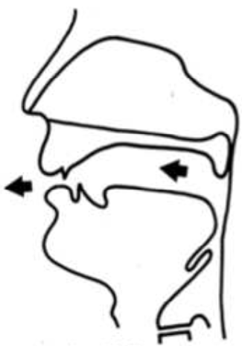
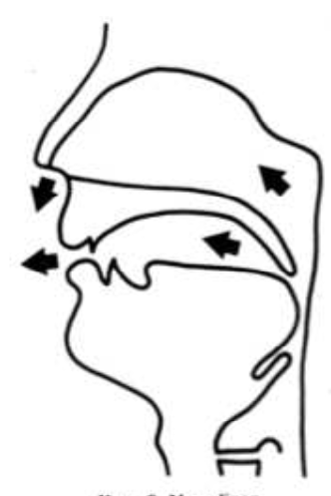
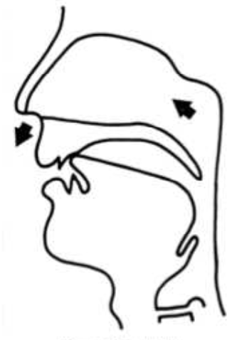
Nasals and nasalization
Normally air flows through mouth only.
Nasals: velopharyngeal port (often just velum) is open, air radiates through nose.
Nasal consonants [n, m, ng]: air flow only through nostrils
Nasalized vowels (e.g., /ɑ̃/): air flow through mouth and nose
normal vowel
nasalized vowel
nasal consonant

Slide 32
Demo
https://dood.al/pinktrombone/

Slide 33
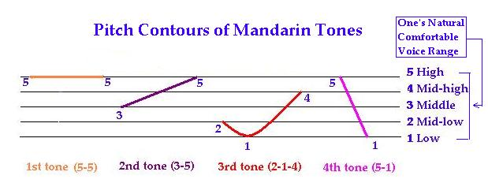
Classification of speech sounds
Some other classification principles:
Pulmonic sounds: exhalation (air-pressure) from lungs. Most phones.
Non-pulmonic sounds: ejectives, implosives and clicks. Uncommon.
Vowel quantity = ”length” of the vowel
Finnish has two quantities: short and long. e.g., [takka] vs. [ta:kka] (fireplace vs. burden)
Estonian has three quantities (short, long, very long).
English doesn’t have quantities.
Tone: fundamental frequency (F0) during a vowel or syllable
Used in tone languages, such as Mandarin Chinese
Level and change (e.g., high falling, medium falling-rising etc.)
Image from http://web.mit.edu/jinzhang/www/pinyin/tones/

Slide 34
Coarticulation

Slide 35
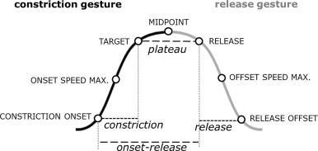
Coarticulation
Articulation takes place at a finite speed.
Instant movement impossible with finite masses.
→ Smooth movement from a vocal tract configuration to another
Only some articulators are critical for intelligible phones.
E.g., tongue position arbitrary during [p] closure.
→ Free articulators can anticipate the forthcoming sound for speedup.
As a result, articulatory and acoustic realizations of a sound depend on the temporal context (previous and next sounds).
Lack of invariance: same phone, different sound in different context.
A huge number of potential contexts.
Exact timing of phone boundaries often vague.
Image from Tilsen (2014)

Slide 36
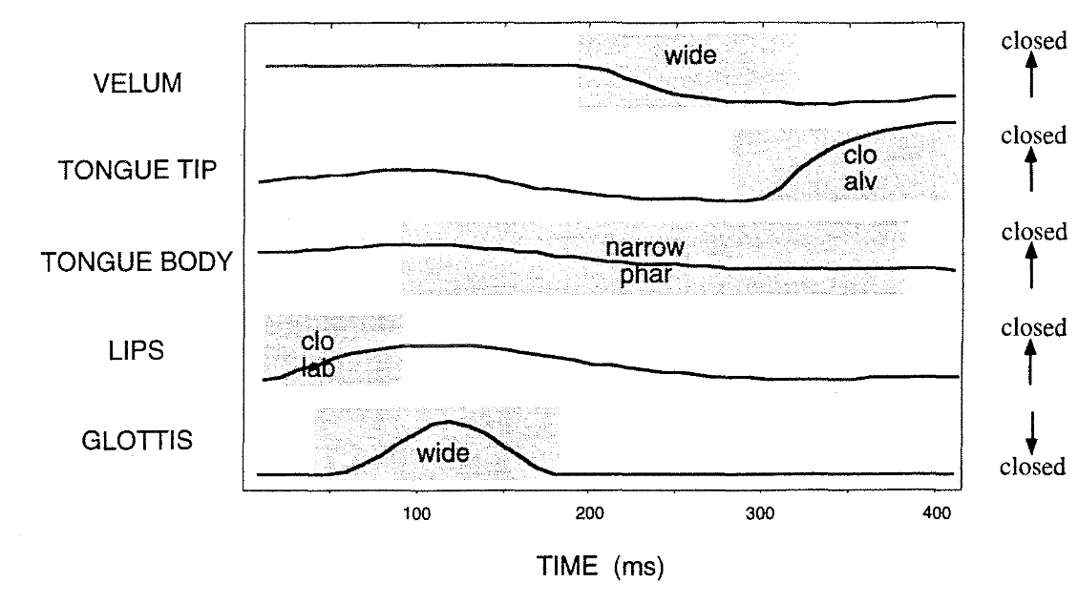
Coarticulation: gestures
Partial articulatory gestures for /’pan/
From Browman & Goldstein (1993)

Slide 37
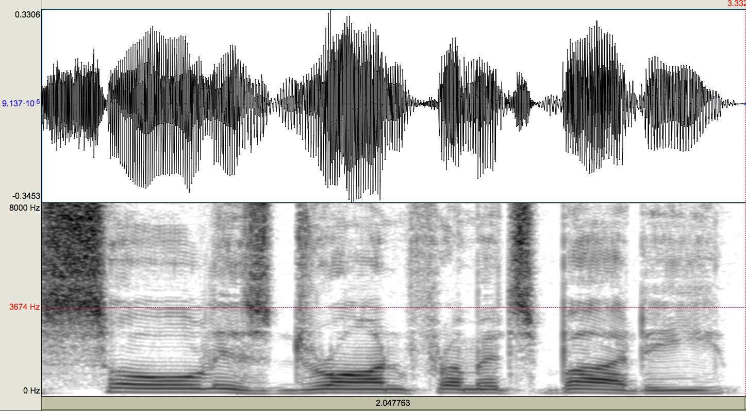
Coarticulation: spectrum
“Soul is drawn from it’s body”

Slide 38
Articulatory effort
Speech production aims to transmit the intended message, not to produce “prototypical” speech.
Minimization of effort (energy expenditure).
Sufficient intelligibility (in a given context).
Hyperarticulation: vowel articulation more peripheral than usually to increase distinctiveness (e.g., exaggarated frontness/backness).
Hypoarticulation: articulation is centralized and fails to reach normal articulatory targets (articulatory undershoot).

Slide 39
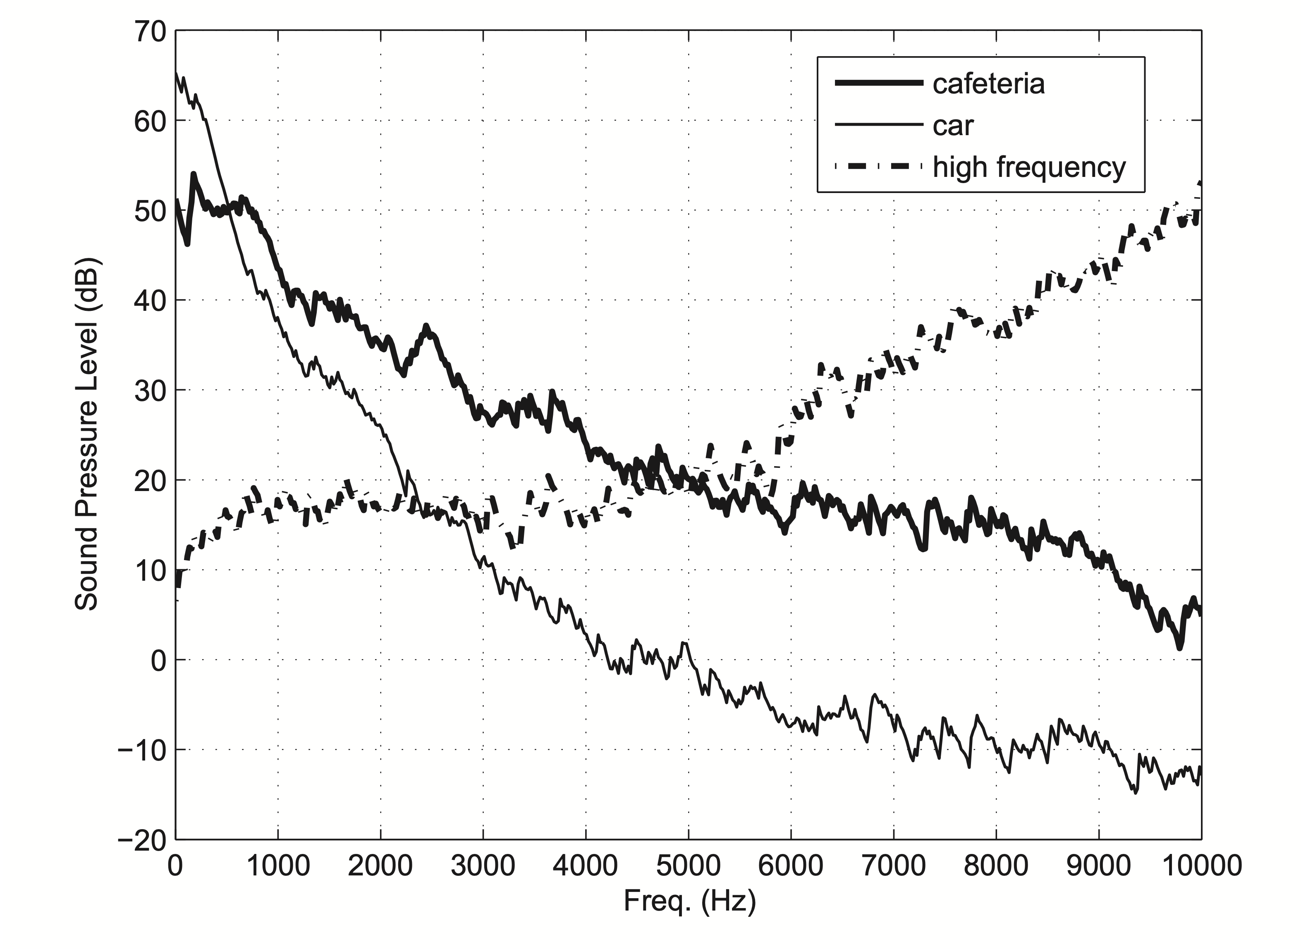
Lombard speech
Lombard speech: automatic changes in speaking style in noisy environments.
Can include modification to loudness, F0, spectral tilt, segment durations, and speaking rate.
General idea: shift speech energy to higher frequencies to avoid noise masking.
From Valentini-Botinhao, Yamagishi & King (2011)

Slide 40
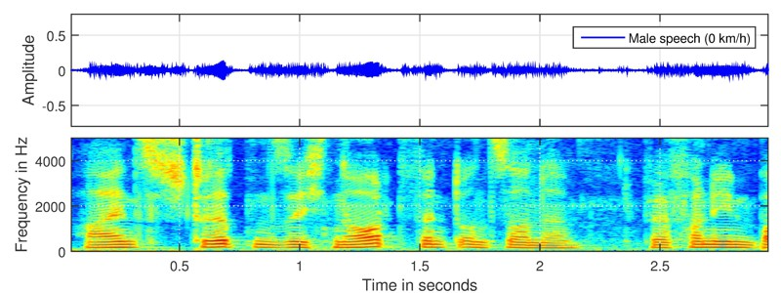
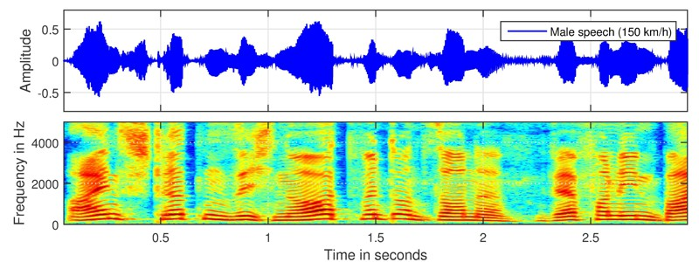
Example: Lombard speech
https://dss-kiel.de/index.php/media-center/audio-examples/lombard-speech-examples

Slide 41
Speech production, summary
Brain controls the muscles responsible for controlling air pressure (diaphragm), vocal folds (larynx muscles), and articulation (primarily jaw, tongue, lips, velum).
Source filter model of speech production:
Vocal folds create periodic excitation for voiced sounds
Articulator positions and movements determine the shape of the tract → filter characteristics → identity of the speech sounds.
Lip radiation acts as a high-pass filter.
Vowels are generated by relatively open vocal tract; consonants by a some kind of constriction in the tract.
Coarticulation: context-dependency of articulatory gestures → context-dependency of acoustic phone realizations.

